Slide 1
Seizure Detection using ML on EEG Signals
Course: MLPP
24SDEC02
Roll no:
2410040039
2410040040

Slide 2
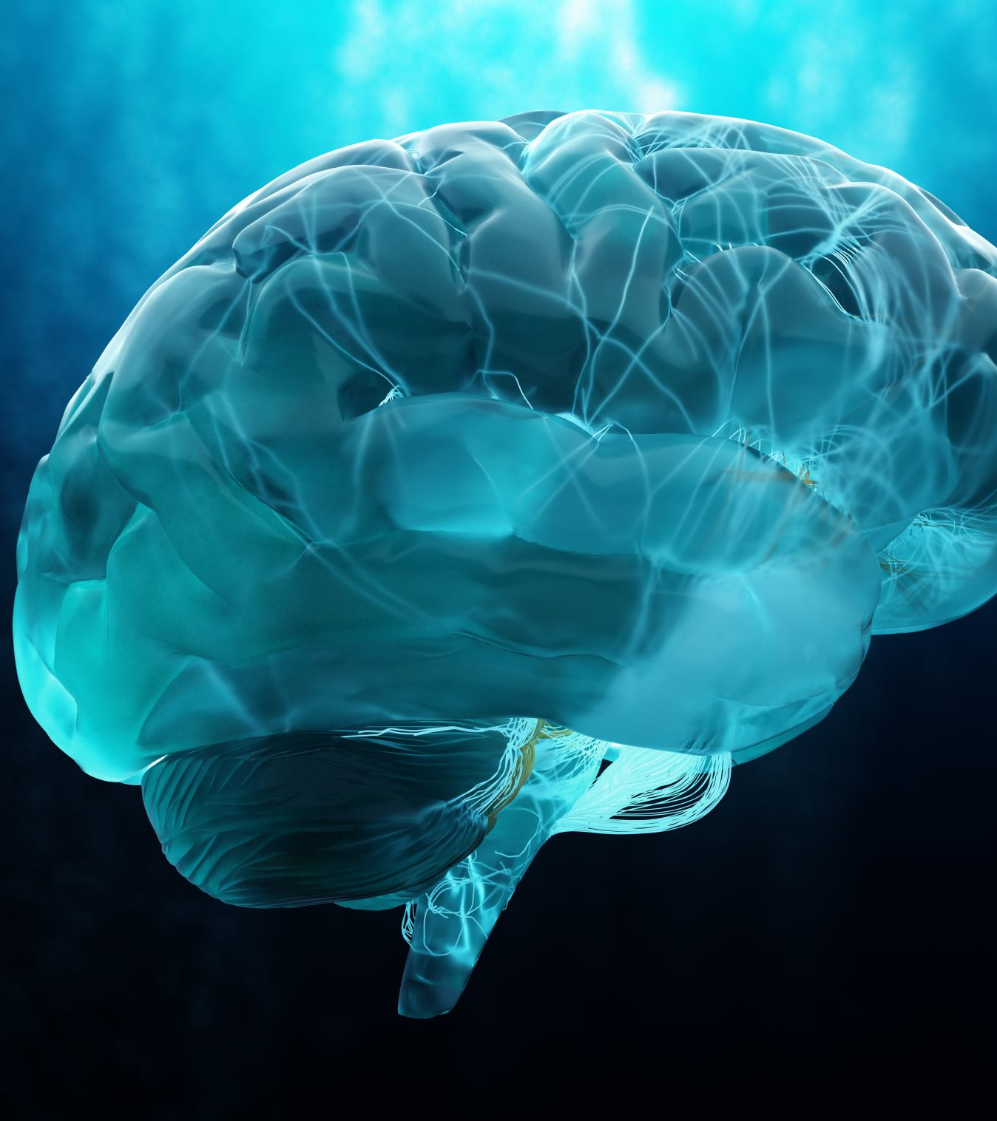
Introduction
Epilepsy is a neurological disorder characterized by sudden, abnormal electrical activity in the brain, leading to seizures.
Electroencephalogram (EEG) records brain signals and is widely used for diagnosis.
However:
Manual EEG analysis is complex
Time-consuming
Requires expert knowledge
Deep learning provides an automated solution for detecting seizures efficiently.

Slide 3
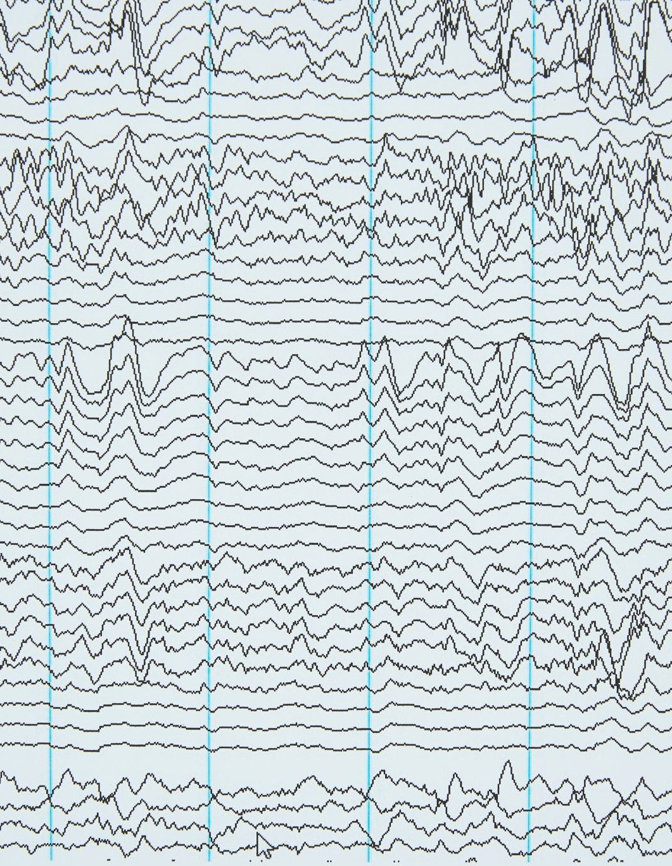
Problem Statement
Detect seizure activity from EEG signals automatically
Reduce reliance on manual analysis
Improve detection speed and accuracy
Enable real-time monitoring systems

Slide 4

Objectives
To analyze and understand raw EEG signal data for seizure patterns
To preprocess EEG signals by applying normalization and noise reduction techniques
To design and implement a Convolutional Neural Network (CNN) for automatic feature extraction
To classify EEG signals into seizure and non-seizure categories
To train and validate the model using efficient training techniques
To evaluate model performance using metrics such as accuracy, precision, recall, and F1-score
To develop an automated and reliable seizure detection system

Slide 5
Dataset
Source: Kaggle EEG dataset
Contains raw EEG signal values
Each sample represents brain activity over time
  Training Samples per Class:
  F: 72
  N: 86
  O: 90
  S: 76
  Z: 76
Dataset is used to train and test the model.
Testing Samples per Class:
F: 28
N: 14
O: 10
S: 24
Z: 24

Slide 6
Methodology
Data Collection
Data Preprocessing
Normalization of signals
CNN Model Training
Prediction
Performance Evaluation
This pipeline ensures accurate seizure detection.

Slide 7
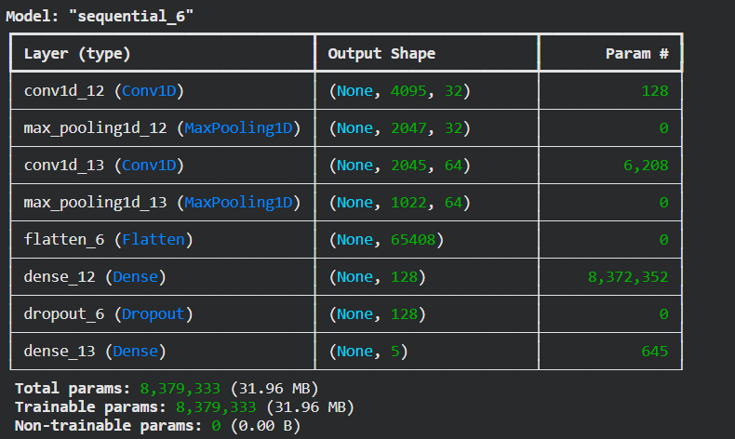
CNN Model
Convolutional Neural Network (CNN) is used for classification.
Key components:
Convolution Layer: extracts features
Pooling Layer: reduces dimensionality
Dense Layer: final classification
Dropout: reduces overfitting
CNN learns patterns automatically without manual feature extraction.

Slide 8
Training Details
Train/Test Split: 80/20
Epochs: 10–20
Batch Size: 32
Optimizer: Adam
Loss Function: Sparse Categorical Crossentropy
These parameters help optimize model performance.

Slide 9
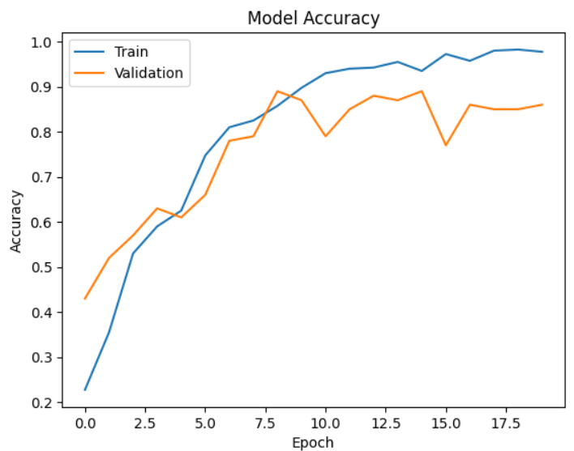
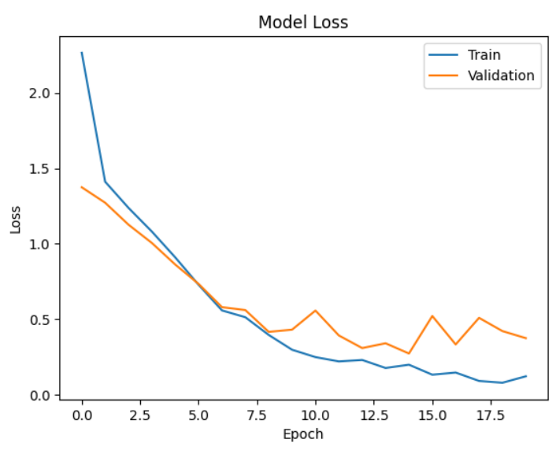
Model Accuracy
Model Loss

Slide 10
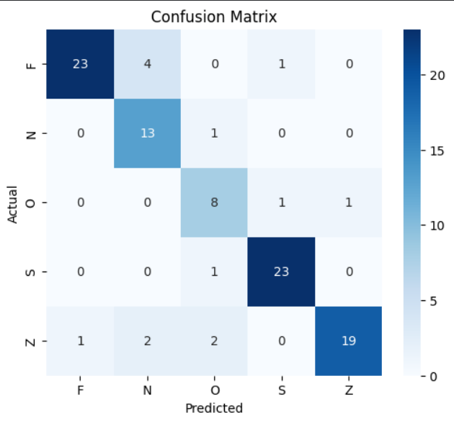
Confusion Matrix
Used to evaluate classification performance
Helps understand model errors.

Slide 11
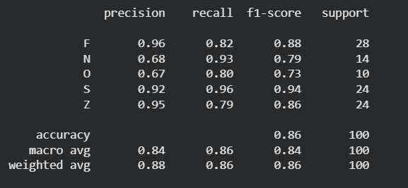
Classification Report

Slide 12

K-Fold Cross Validation
K-Fold Cross Validation is used to evaluate model performance more reliably
The dataset is divided into K equal parts (folds)
The model is trained on K-1 folds and tested on 1 fold
This process is repeated K times
Final performance is the average of all folds
5-Fold Cross Validation

Slide 13
🔹 Fold 1
Accuracy: 0.8000
🔹 Fold 2
Accuracy: 0.8000
🔹 Fold 3
Accuracy: 0.8400
🔹 Fold 4
Accuracy: 0.7900
🔹 Fold 5
Accuracy: 0.8300
K-Fold Accuracies: [0.800000011920929, 0.800000011920929, 0.8399999737739563, 0.7900000214576721, 0.8299999833106995]
Average Accuracy: 0.8120000004768372

Slide 14
ROC Curve
ROC = Receiver Operating Characteristic Curve
It shows performance of classification model
Plots:
  X-axis → False Positive Rate (FPR)
  Y-axis → True Positive Rate (TPR)
It shows how well the model separates classes
ROC Curve Interpretation
Curve closer to top-left corner → better model
Diagonal line → random guessing
Higher AUC → better classification

Slide 15
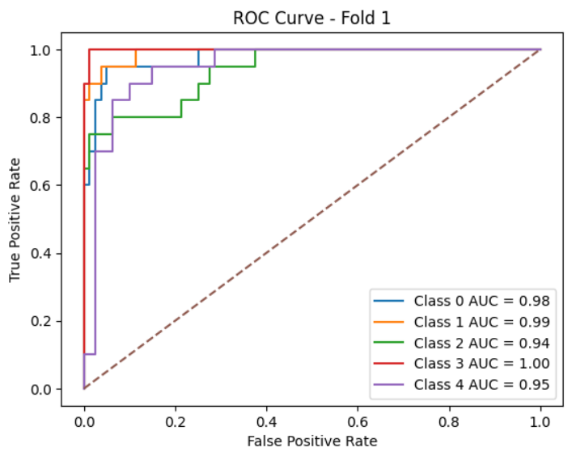
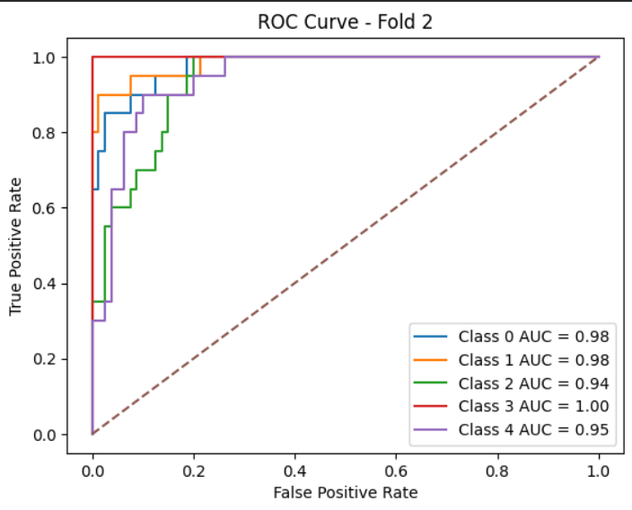
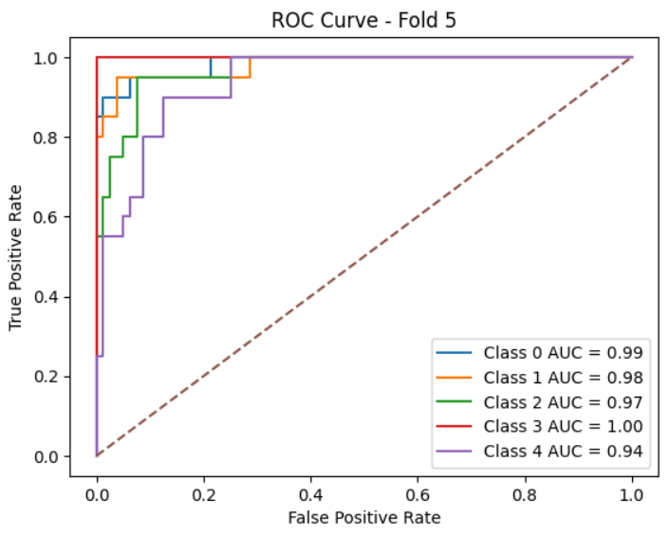
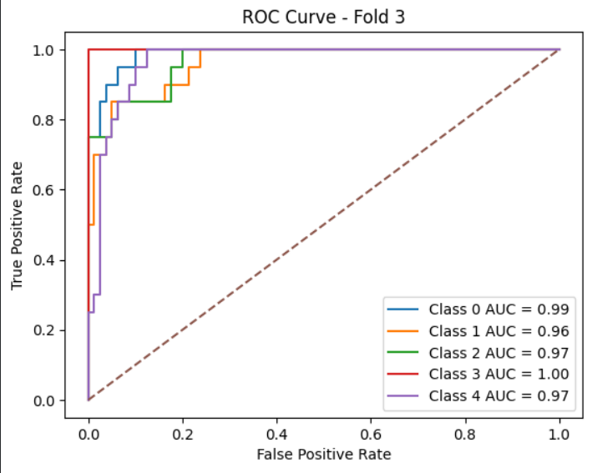
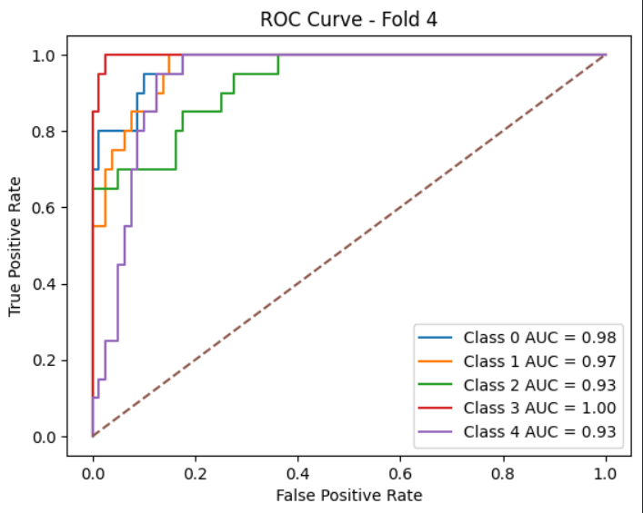

Slide 16
Conclusion
A CNN-based model was successfully developed for seizure detection using raw EEG signals
The model effectively learned patterns and classified signals into seizure and non-seizure categories
Performance evaluation using accuracy, confusion matrix, ROC curve, and AUC score showed reliable results
Use of K-Fold Cross Validation improved model robustness and reduced overfitting
The proposed system provides an automated, efficient, and accurate solution for seizure detection
Overall, the model demonstrates strong potential for assisting in medical diagnosis and real-time monitoring systems

